Slide 1
Customer Retention
By: Kavisha Arora

Slide 2
Customer Retention?
Customer Retention means retaining first-time customers and preventing them from switching to a rival is known as customer retention. It shows how loyal customers are to a product or service as well as its quality.
Existing clients are the primary focus of customer retention.
Through superior customer service, product value, and a distinct advantage over similar products or services, the objective is to build customer loyalty and increase repeat purchases.
Retaining your customers is essential for generating repeat business and ongoing value.
Understanding your customers' satisfaction and loyalty are two of the most crucial aspects of improving customer retention.

Slide 3
How to retain customers?
Make sure the onboarding process is successful.
Provide individualized services to customers.
Establish trust with your clients.
Put in place a feedback loop for customers.
Create a calendar for communicating with customers.
Make customers the first priority.

Slide 4
Benefits of customer retention
Encourage long-term company expansion.
Make each sale worth more to each customer.
Increase referrals and customer loyalty while lowering your acquisition costs by better understanding your customers' motivations.
Develop better products, faster.
Experiment safely with customers who are open to change.

Slide 5
customer retention rate
(Total customers at end of period – new customers acquired) / Customers at beginning of period * 100

Slide 6
Explanatory data analysis
We have data of five companies that is Amazon, Flipkart, Myntra, Paytm , Snapdeal.
We will do analysis of our data with hedonic values and utilitarian values.
Hedonic perspective is that customers are looking to derive pleasure from the product or service.

Slide 7
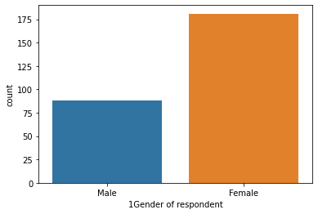
Data analysis females customers are more in comparison to men

Slide 8
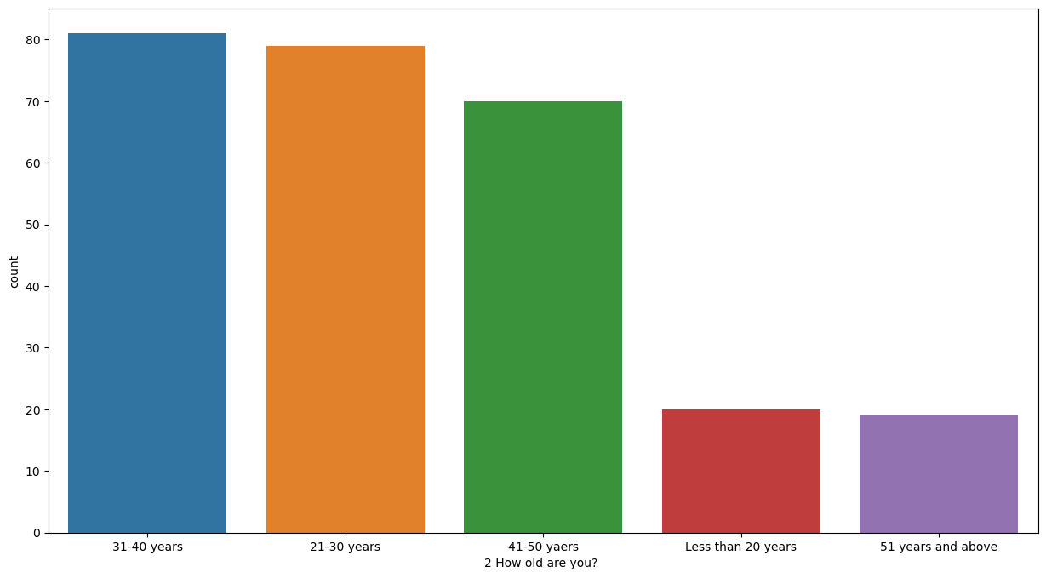
People aged 31-40 years are potential customers

Slide 9
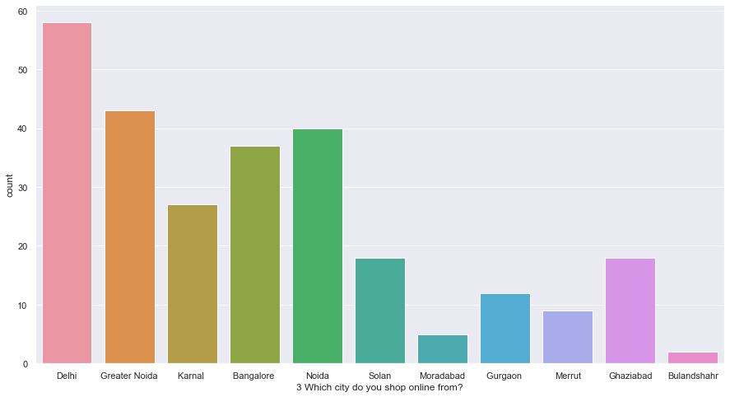
Delhi has the highest number of customers.

Slide 10
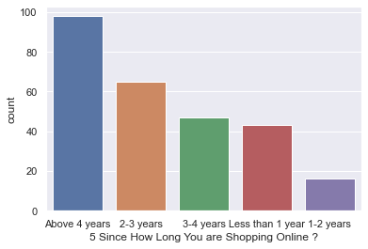
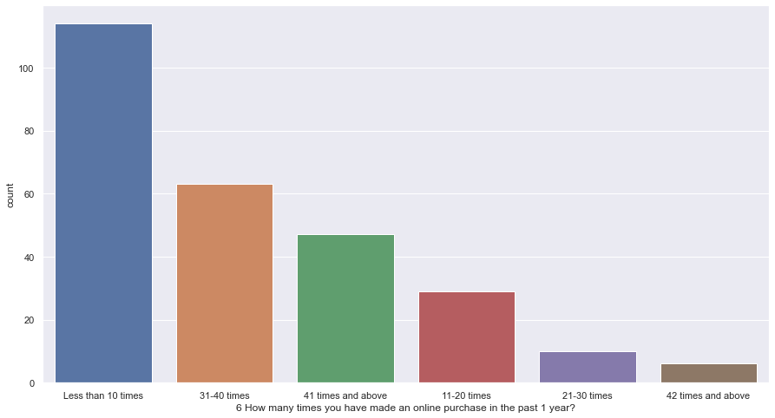
People are shopping above 4 years and has made an online purchase less than 10 times.

Slide 11
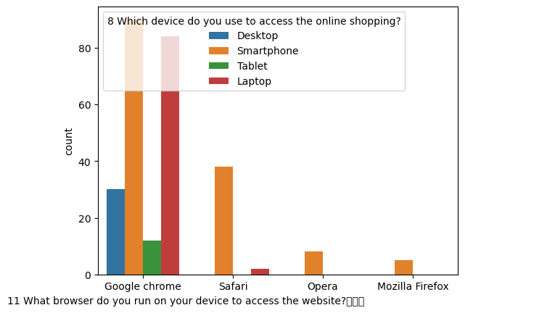
How they do shopping?

Slide 12
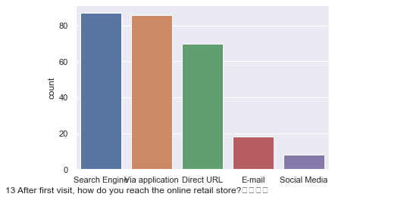
How customer reached to online website?

Slide 13
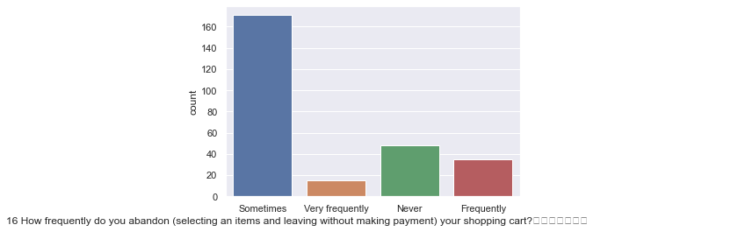
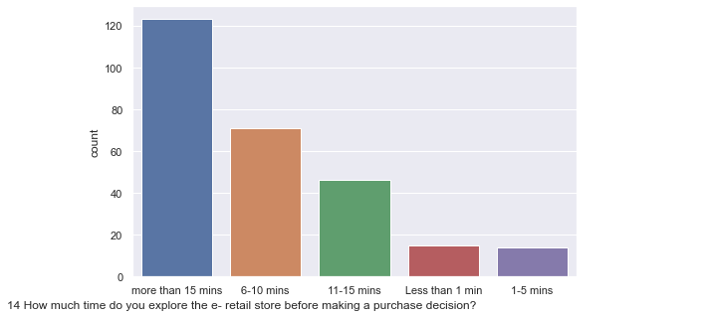
Customer habits like time they spend and abandon the cart.

Slide 14
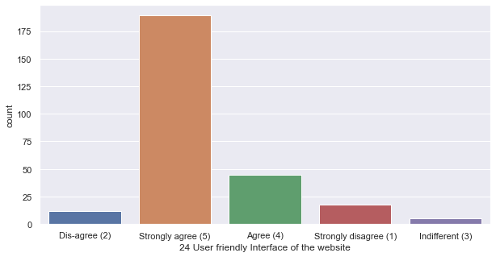
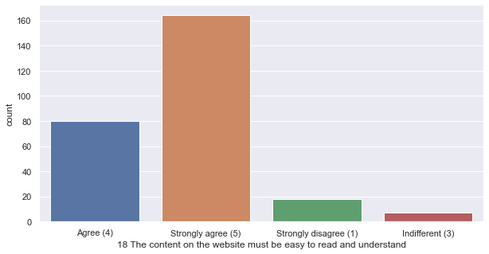
About Website

Slide 15
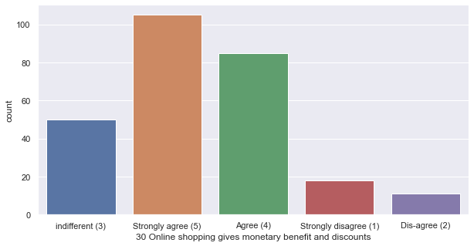
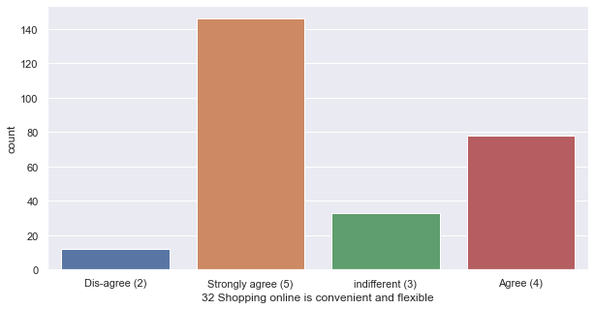
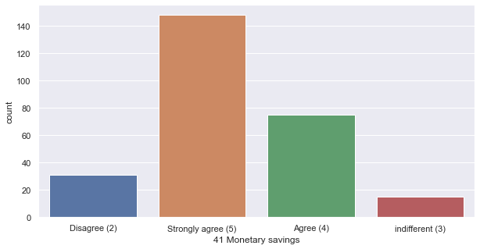
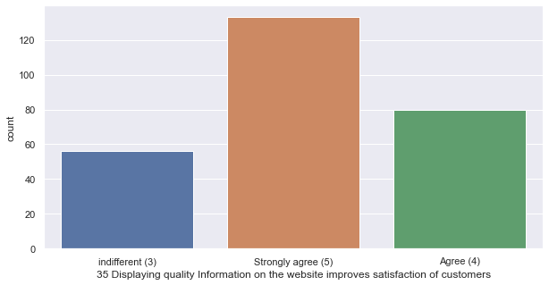
.

Slide 16
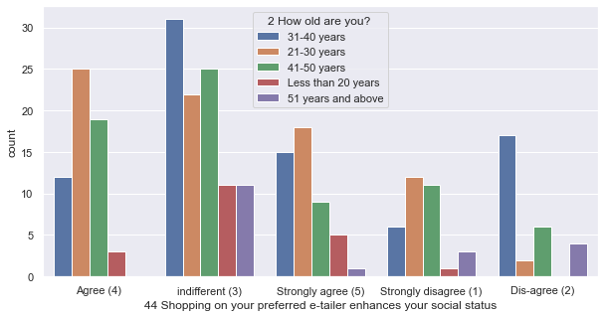
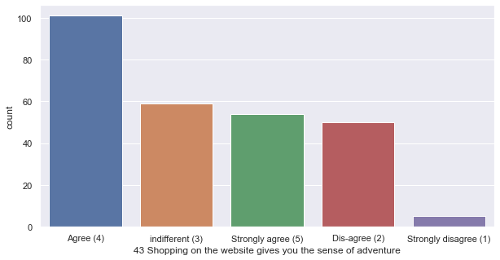
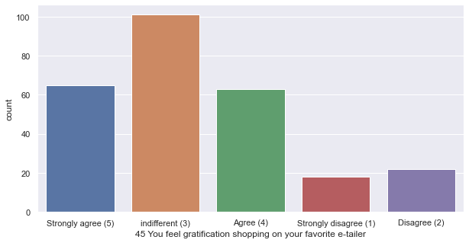
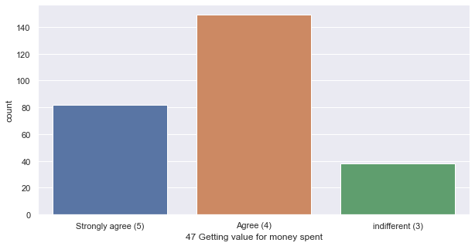
Hedonic values

Slide 17
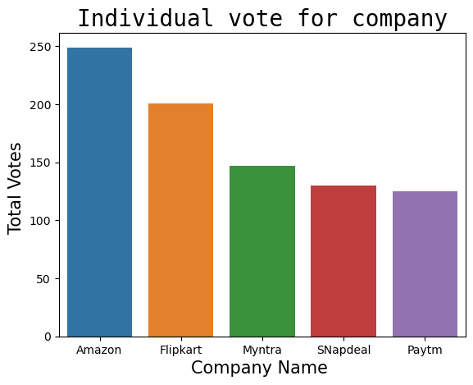
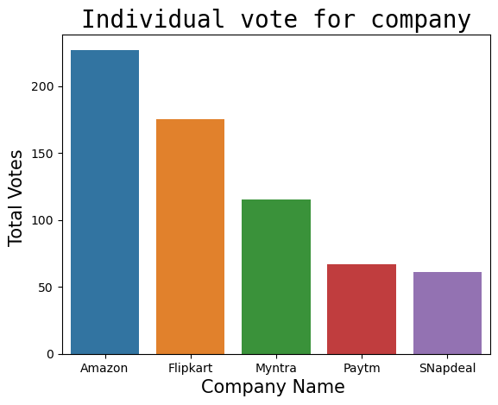
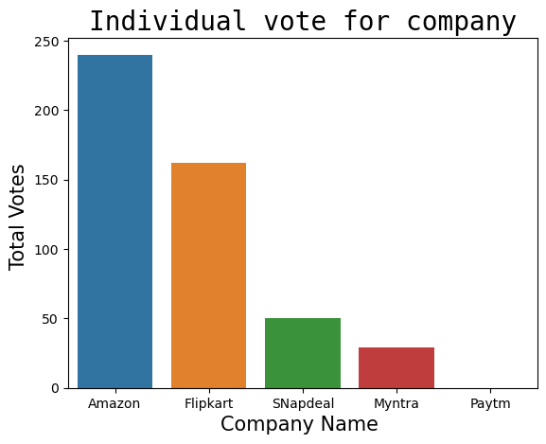
Which company is preferred the most?
Visual appealing web-page layout choices
Easy to use website
Followed by Flipkart in second place
Amazon is the most preferred in case of easy to use website, visual appealing web page layout and speedy over delivery
Speedy over delivery

Slide 18
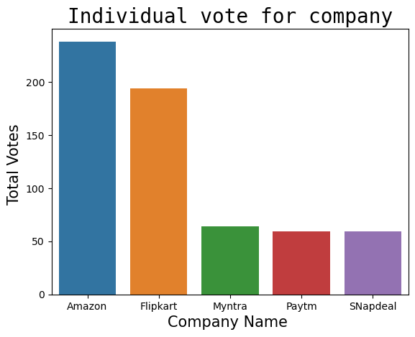
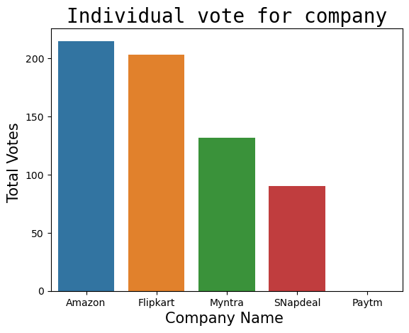
Which company has high product availability?
Wild Variety of Product
Complete, relevant description information of products
several payment options

Slide 19
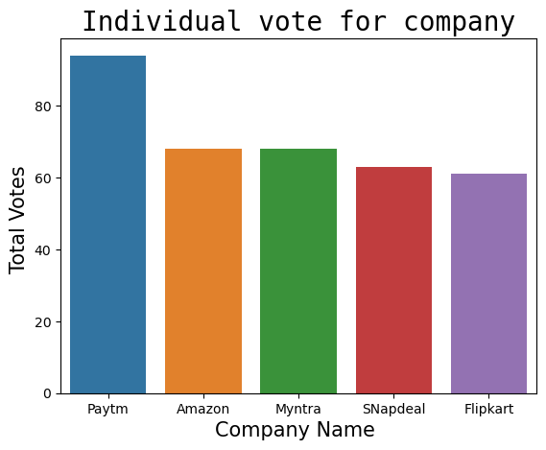
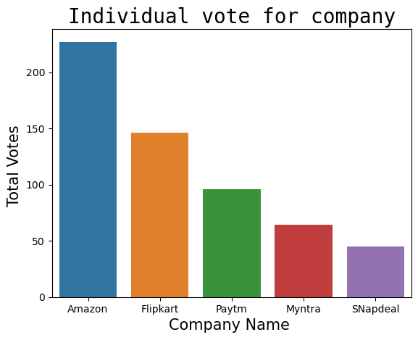
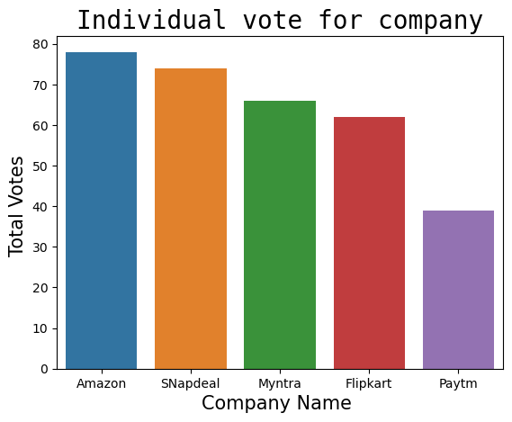
Technical performance
Longer page loading time
Reliability of the website
Frequent distruption on page change

Slide 20
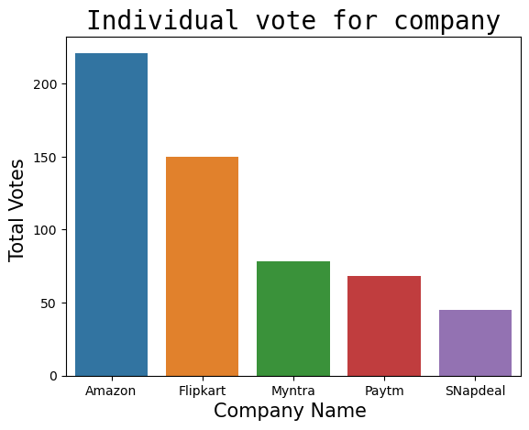
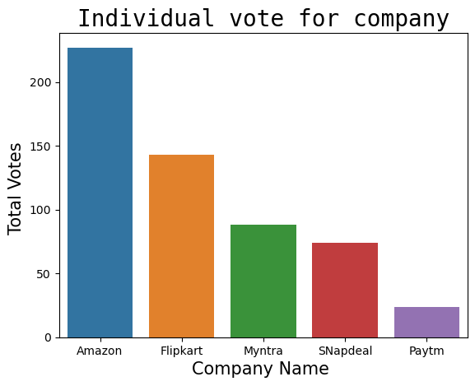
Privacy of customer.
Security of customer financial information
Privacy of customer informtion
Trustworthiness

Slide 21
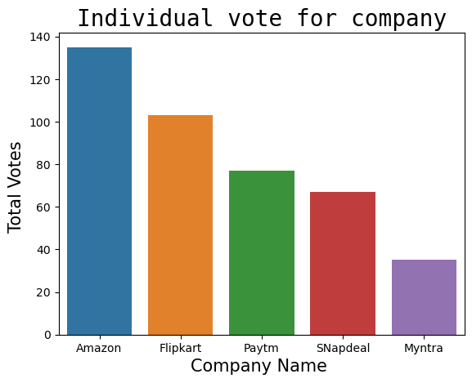
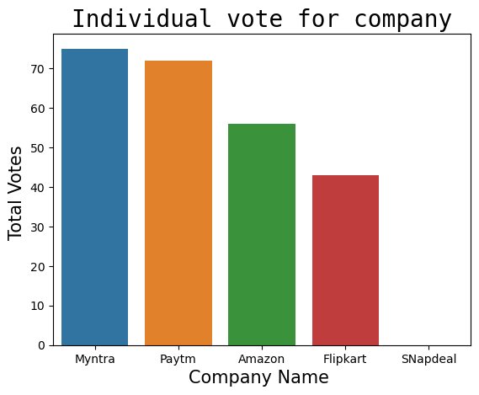
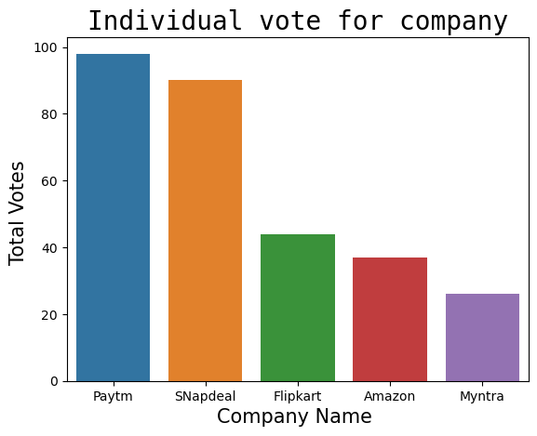
Performance during sales
Longer time to get logged in
Late declaration of price
Amazon is the most favourite website but during sales its performance is not that much good.
Longer Delivery period

Slide 22
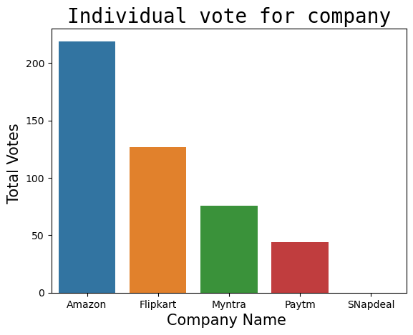
Which of the Indian online retailer would you recommend to a friend?
Amazon is the most recommended one.

Slide 23

After endoing, correlation defined
Correlation means two variables are linearly related.

